Slide 1

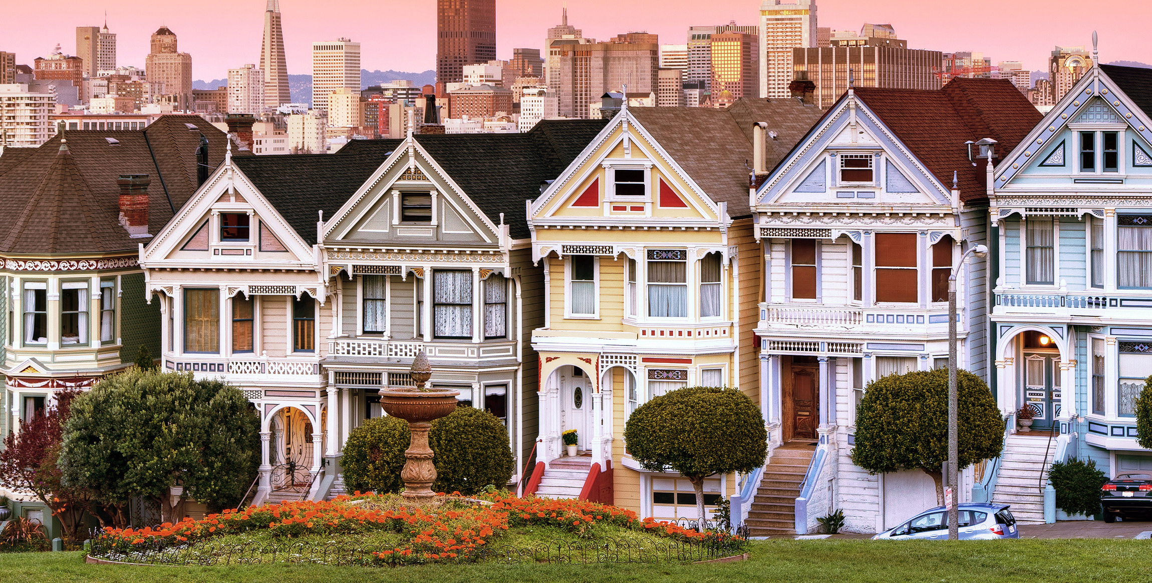
Machine learning with domestic energy use data
sam stern

Slide 2

Motivation
Government plans on installing SMARTMETERS throughout the UK by 2020
Readings taken by SMARTMETERS stored on a database
What are the security implication?
Taking on the role on an attacker who has hacked into the database and stolen electricity readings.
What can you infer from the data?

Slide 3
Hes dataset
250 households
26 for 1 year
224 for (roughly) 1 month
Energy measured in either 2 or 10 minute intervals

Slide 4
Pre-proCessing
1 month
easy to implement
lost too much data
4 weeks
What about weekly patterns (energy use different on weekends)
for 1 month
chop top off
it remaining data <28 days
recycle/re-use data
For 1 year
chop top off
cut into 28 day intervals
cut into 28 day segments
5 | 6 | 7 | 1 | 2 | 3 | 4 | 5 | 6 | 7 | 1 | 2 | 3 | 4 | 5 | 6 | 7 | 1 | 2 | 3 | 4 | 5 | 6 | 7 | 1 | 2 | 3
5 | 6 | 7 |  | 1 | 2 | 3 | 4 | 5 | 6 | 7 | 1 | 2 | 3 | 4 | 5 | 6 | 7 | 1 | 2 | 3 | 4 | 5 | 6 | 7 | 1 | 2 | 3
1 | 2 | 3 | 4 | 5 | 6 | 7 | 1 | 2 | 3 | 4 | 5 | 6 | 7 | 1 | 2 | 3 | 4 | 5 | 6 | 7 | 1 | 2 | 3 | 4 | 5 | 6 | 7
1 | 2 | 3 | 4 | 5 | 6 | 7 | 1 | 2 | 3 | 4 | 5 | 6 | 7 | 1 | 2 | 3 | 4 | 5 | 6 | 7 | 1 | 2 | 3 | 4 | 5 | 6 | 7

Slide 5
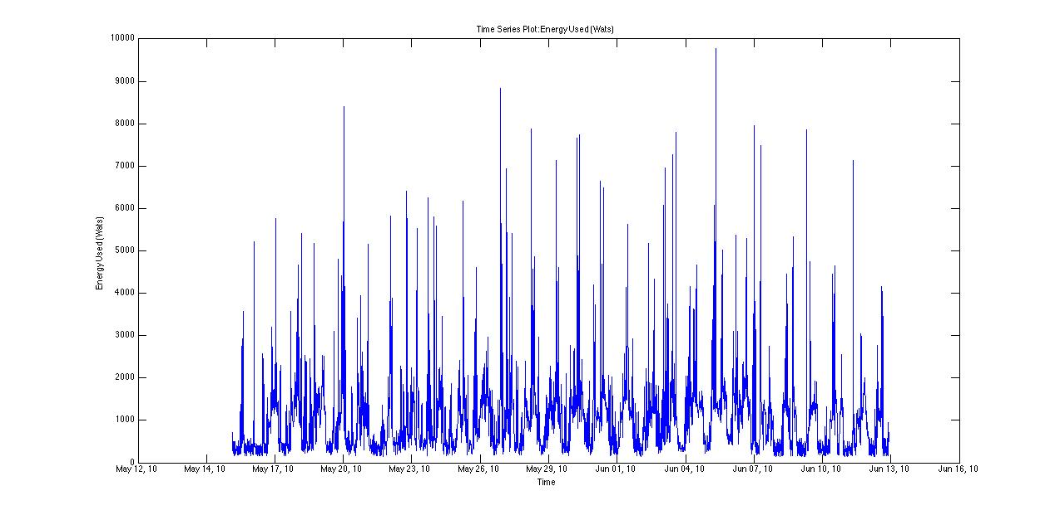

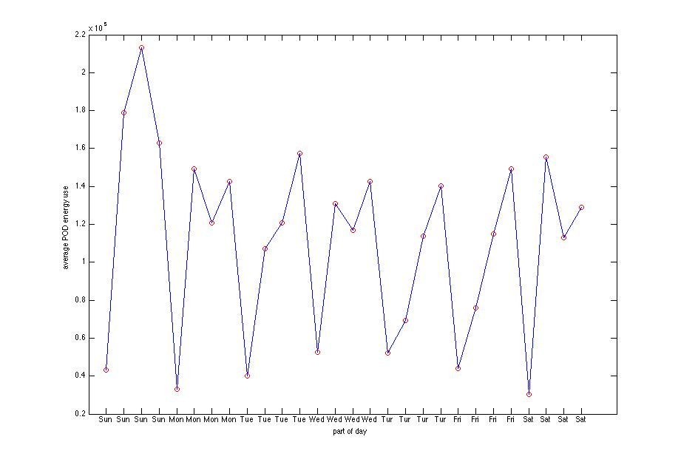

Slide 6
Classifiers
Logistic Regression
Children vs. No Children –81% accuracy
Socio-Economic Status – 34% accuracy
Random Forrest
Children vs. No Children --80% accuracy
Socio-Economic Status -49% accuracy
Notes:
----- Meeting Notes (09/02/15 12:23) -----
ordinal regression

Slide 7
still to do
Classification Measures
Precision, recall etc
Write Report
Notes:
----- Meeting Notes (09/02/15 12:23) -----
ROC
Confusion matrix
particularly for socio-economic

